Slide 1
Chapter 4 Container Orchestration Using Kubernetes

Slide 2
Learning Topics
Deploy Compose App in K8
API & Objects
Networking
Services
Replica Sets
Deployments
Storage
Auto Scaling for Apps
Horizontal Pod Auto Scaler

Slide 3
Lab 4 – Deploy & Expose App
Deploy Multi-Tier App in K8 that was Deployed in Docker
Uses Kompose to convert Docker Compose files to be deployed in K8

Slide 4
API Overview
The REST API (API-Server) is the keystone of Kubernetes
Every component communicates with API-Server
Everything within Kubernetes is an API Object
Object Oriented Application Architecture

Slide 5
API Groups
Every object in kubernetes belongs to an API Group
The API Group is a REST compatible path
Format:
/apis/<group>/<version>/<resource>
Examples:
/apis/apps/v1/deployments
/apis/batch/v1beta1/cronjobs

Slide 6
API Versioning
3 tiers of API Maturity Level
Alpha – May be buggy, disabled by default
Beta – Code is well tested, enabled by default
Stable – Released, stable and API schema will not change.
https://kubernetes.io/docs/concepts/overview/kubernetes-api/#api-versioning

Slide 7
Kubernetes Objects
Persistent entities in the kubernetes system
Kubernetes uses these entities to represent the state of cluster
What containerized applications are running (and on which nodes)
The resources available to those applications
The policies around how those applications behave, such as restart policies, upgrades, and fault-tolerance

Slide 8
Kubernetes Objects Cont.
Record of Intent
Once object is created, kubernetes will constantly work to ensure that object exists
Tells about desired state of cluster
Need to use kubernetes API to create/modify/delete objects
Includes 2 nested object fields
Spec – You must provide, describes your desired state for the object
Status – Describes actual state of the object, supplied and updated by kubernetes

Slide 9
Describe Kubernetes Objects
Often, information is provided in a .yaml file to kubectl
Kubectl converts the information to JSON when making the API request.
Example Object
apiVersion: v1
kind: Pod
metadata:
name: pod-example
spec:
containers:
- name: nginx
image: nginx:stable-alpine
ports:
- containerPort: 80
Example Status Snippet
status:
conditions:
- lastProbeTime: null
lastTransitionTime: 2018-02-14T14:15:52Z
status: "True"
type: Ready
- lastProbeTime: null
lastTransitionTime: 2018-02-14T14:15:49Z
status: "True"
type: Initialized
- lastProbeTime: null
lastTransitionTime: 2018-02-14T14:15:49Z
status: "True"
type: PodScheduled

Slide 10
Lab 5 – Deployment Objects
Create an YAML
Describe all objects
Deploy these objects
Walkthrough Deployment.YAML

Slide 11
Kubernetes Networking
Pod Network
Cluster-wide network used for pod-to-pod communication managed by a CNI (Container Network Interface) plugin.
Service Network
Cluster-wide range of Virtual IPs managed by kube-proxy for service discovery.

Slide 12
Kubernetes Networking
Unlike Docker, every pod gets its own cluster wide unique IP, and makes use of the CNI plugin
Services are a separate range of static non-routable virtual IPs that are used like an internal LB or static IP
Service IPs are special and can’t be treated like a normal IP, they are a ‘mapping’ stored and managed by kube-proxy
Pod IPs are pingable
Service IPs are not

Slide 13
Container Network Interface (CNI)
Pod networking within Kubernetes is plumbed via the Container Network Interface (CNI).
Functions as an interface between the container runtime and a network implementation plugin.
CNCF Project
Uses a simple JSON Schema.
CNI runtime focuses solely on container lifecycle connectivity

Slide 14
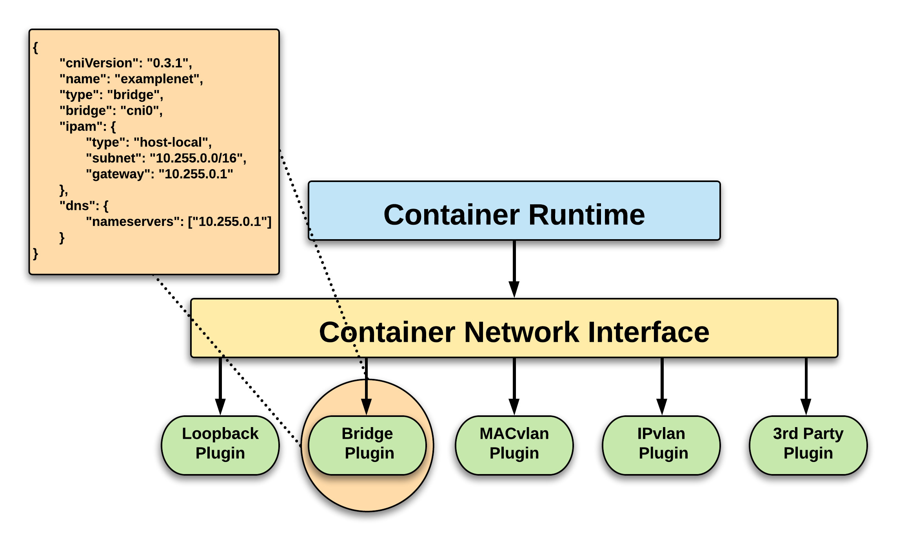
CNI Overview

Slide 15

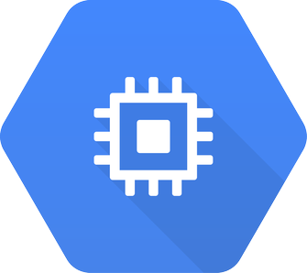







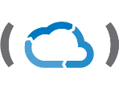

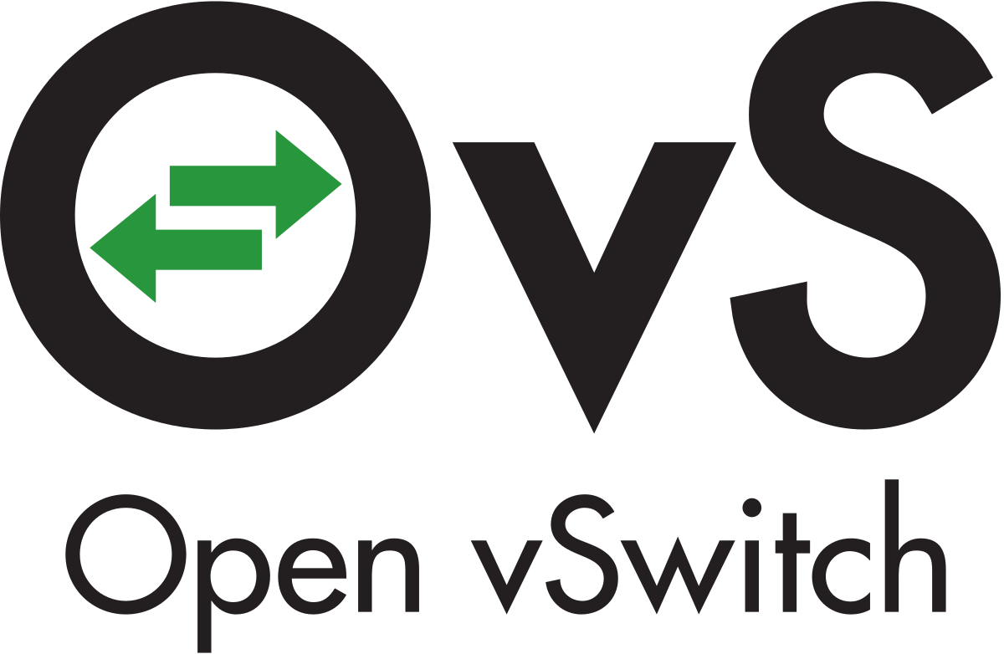
CNI Plugins
Amazon ECS
Calico
Cillium
Contiv
Contrail
Flannel
GCE
kube-router
Multus
OpenVSwitch
Romana
Weave

Slide 16
Fundamental Networking Rules
All containers within a pod can communicate with each other unimpeded.
All Pods can communicate with all other Pods without NAT.
All nodes can communicate with all Pods (and vice-versa) without NAT.
The IP that a Pod sees itself as is the same IP that others see it as.
Pods are given a cluster unique IP for the duration of its lifecycle.

Slide 17
Fundamental Networking Rules - II
Container-to-Container
Containers within a pod exist within the same network namespace and share an IP.
Enables intrapod communication over localhost.
Pod-to-Pod
Allocated cluster unique IP for the duration of its life cycle.
Pods themselves are fundamentally ephemeral.

Slide 18
Fundamental Networking Rules - III
Pod-to-Service
managed by kube-proxy and given a persistent cluster unique IP
exists beyond a Pod’s lifecycle
kubernetes creates a cluster-wide IP that can map to n-number of pods
External-to-Service
Handled by kube-proxy.
Works in cooperation with a cloud provider or other external entity (load balancer).

Slide 19
Services
A kubernetes Service is an abstraction which defines a logical set of Pods and a policy by which to access them
Unified method of accessing the exposed workloads of Pods
Durable resource
Uses kube-proxy to provide simple load balancing

Slide 20
Service Types
4 Major Publishing Service Types
ClusterIP (default)
NodePort
LoadBalancer
Ingress

Slide 21
ClusterIP Service
ClusterIP is an internal LB for your application
Exposes a service on a strictly cluster internal virtual IP

Slide 22
NodePort Service
Exposes the service on each Node’s IP at a static port (the NodePort)
NodePort behaves just like ClusterIP, except it also exposes the service on a (random or specified) port on every Node in your cluster.
Port can either be statically defined, or dynamically taken from a range between 30000-32767.
You’ll be able to contact the NodePort service, from outside the cluster, by requesting <NodeIP>:<NodePort>

Slide 23
LoadBalancer Service
Exposes the service externally using a cloud provider’s load balancer
NodePort and ClusterIP services, to which the external load balancer will route, are automatically created.

Slide 24
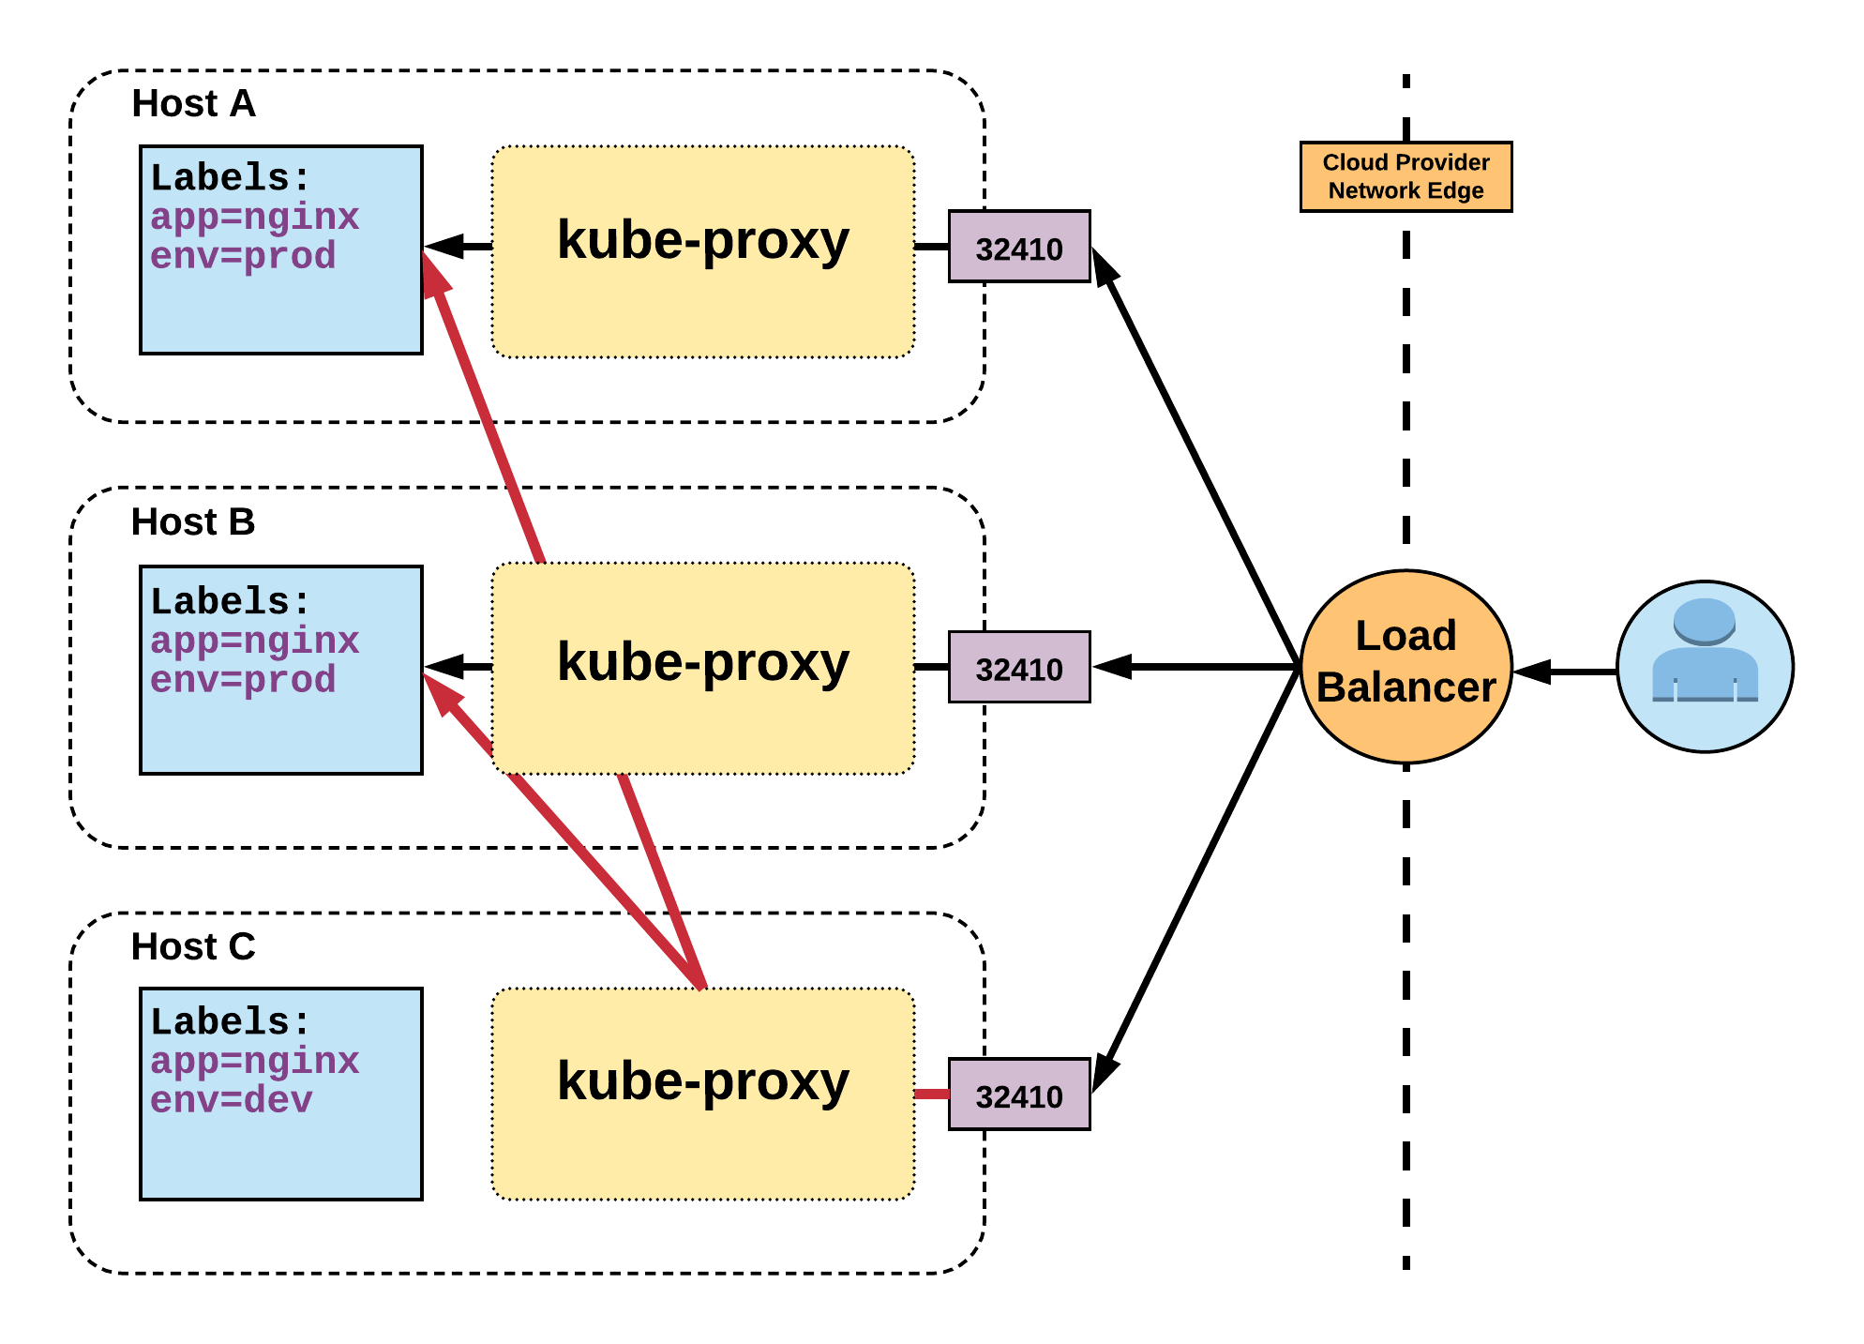
LoadBalancer Service Cont.
Name: example-prod
Selector: app=nginx,env=prod
Type: LoadBalancer
IP: 10.96.28.176
LoadBalancer Ingress: 172.17.18.43
Port: <unset> 80/TCP
TargetPort: 80/TCP
NodePort: <unset> 32410/TCP
Endpoints: 10.255.16.3:80, 10.255.16.4:80

Slide 25
ExternalName Service
Maps the service to the contents of the externalName field (e.g. app1.prod.example.com)
ExternalName is used to reference endpoints OUTSIDE the cluster.
Creates an internal CNAME DNS entry that aliases another.

Slide 26
Ingress
An API object that manages external access to the services in a cluster, typically HTTP
Traffic routing is controlled by rules defined on the ingress resource
An ingress does not expose arbitrary ports or protocols
In order for the ingress resource to work, the cluster must have an ingress controller running

Slide 27
Replica Sets
Primary method of managing pod replicas and their lifecycle
Includes their scheduling, scaling, and deletion.
Their job is simple: Always ensure the desired number of pods are running.
You define the number of pods you want running with the replicas field.
Pods are created with name based off replicaset name + random 5 character string

Slide 28
Replica Sets Cont.
apiVersion: apps/v1
kind: ReplicaSet
metadata:
name: rs-example
spec:
replicas: 3
selector:
matchLabels:
app: nginx env: prod
template:
metadata:
labels:
app: nginx
env: prod
spec:
containers:
- name: nginx
image: nginx:stable-alpine
ports:
- containerPort: 80
$ kubectl get pods
NAME READY STATUS RESTARTS AGE
rs-example-9l4dt 1/1 Running 0 1h
rs-example-b7bcg 1/1 Running 0 1h
rs-example-mkll2 1/1 Running 0 1h
$ kubectl describe rs rs-example
Name: rs-example
Namespace: default
Selector: app=nginx,env=prod
Labels: app=nginx
env=prod
Annotations: <none>
Replicas: 3 current / 3 desired
Pods Status: 3 Running / 0 Waiting / 0 Succeeded / 0 Failed
Pod Template:
Labels: app=nginx
env=prod
Containers:
nginx:
Image: nginx:stable-alpine
Port: 80/TCP
Environment: <none>
Mounts: <none>
Volumes: <none>
Events:
Type Reason Age From Message
---- ------ ---- ---- -------
Normal SuccessfulCreate 16s replicaset-controller Created pod: rs-example-mkll2
Normal SuccessfulCreate 16s replicaset-controller Created pod: rs-example-b7bcg
Normal SuccessfulCreate 16s replicaset-controller Created pod: rs-example-9l4dt

Slide 29
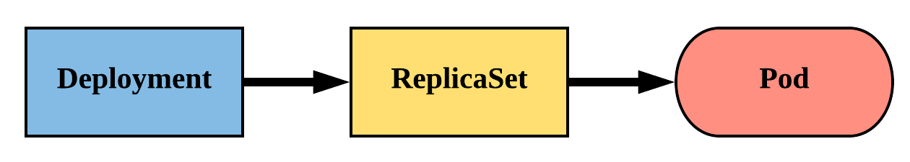
Deployments
Declarative method of managing Pods via ReplicaSets
Provides rollback functionality and update control
Updates are managed through the pod-template-hash label
Each iteration creates a unique label that is assigned to both the ReplicaSet and subsequent Pods

Slide 30
Deployments Cont.
revisionHistoryLimit: The number of previous iterations of the Deployment to retain.
strategy: Describes the method of updating the Pods based on the type. Valid options are Recreate or RollingUpdate.
Recreate: All existing Pods are killed before the new ones are created.
RollingUpdate: Cycles through updating the Pods according to the parameters: maxSurge and maxUnavailable.
maxSurge == how many ADDITIONAL replicas we want to spin up while updating
apiVersion: apps/v1
kind: Deployment
metadata:
name: deploy-example
spec:
replicas: 3 revisionHistoryLimit: 3
selector:
matchLabels:
app: nginx env: prod
strategy:
type: RollingUpdate
rollingUpdate:
maxSurge: 1
maxUnavailable: 0
template:
<pod template>

Slide 31
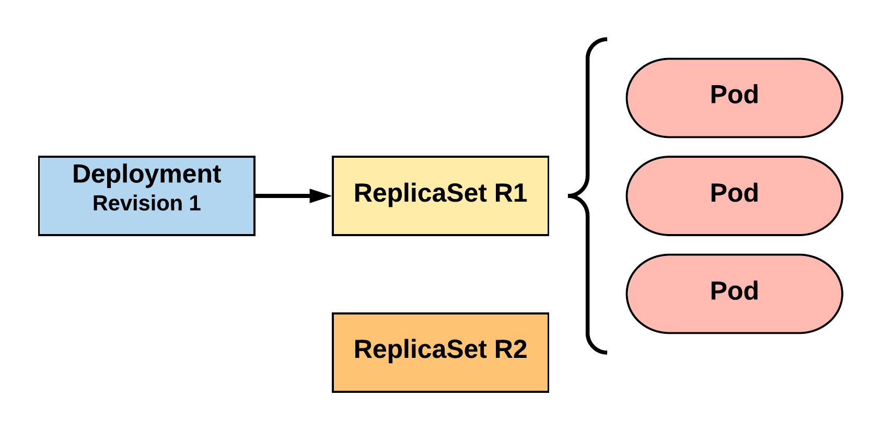
RollingUpdate Deployment
Updating pod template generates a new ReplicaSet revision.
R1 pod-template-hash: 676677fff
R2 pod-template-hash: 54f7ff7d6d
$ kubectl get replicaset
NAME DESIRED CURRENT READY AGE
mydep-6766777fff 3 3 3 5h
$ kubectl get pods
NAME READY STATUS RESTARTS AGE
mydep-6766777fff-9r2zn 1/1 Running 0 5h
mydep-6766777fff-hsfz9 1/1 Running 0 5h
mydep-6766777fff-sjxhf 1/1 Running 0 5h
Notes:
We add a new label, change the image, do something to change the pod template in some way
The deployment controller creates a new replicaset with 0 instances to start

Slide 32
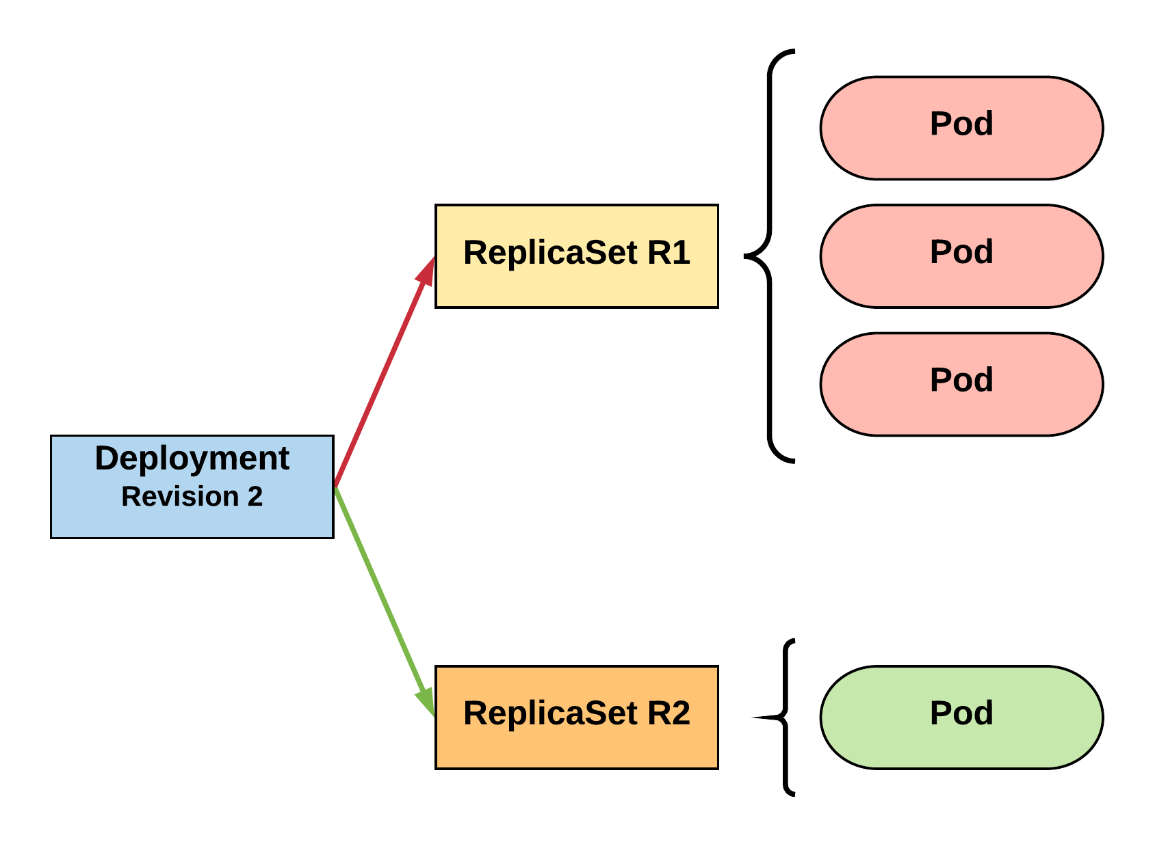
RollingUpdate Deployment
New ReplicaSet is initially scaled up based on maxSurge.
R1 pod-template-hash: 676677fff
R2 pod-template-hash: 54f7ff7d6d
$ kubectl get replicaset
NAME DESIRED CURRENT READY AGE mydep-54f7ff7d6d 1 1 1 5s
mydep-6766777fff 2 3 3 5h
$ kubectl get pods
NAME READY STATUS RESTARTS AGE
mydep-54f7ff7d6d-9gvll 1/1 Running 0 2s
mydep-6766777fff-9r2zn 1/1 Running 0 5h
mydep-6766777fff-hsfz9 1/1 Running 0 5h
mydep-6766777fff-sjxhf 1/1 Running 0 5h
Notes:
It then scales up the new ReplicaSet based on our maxSurge value

Slide 33
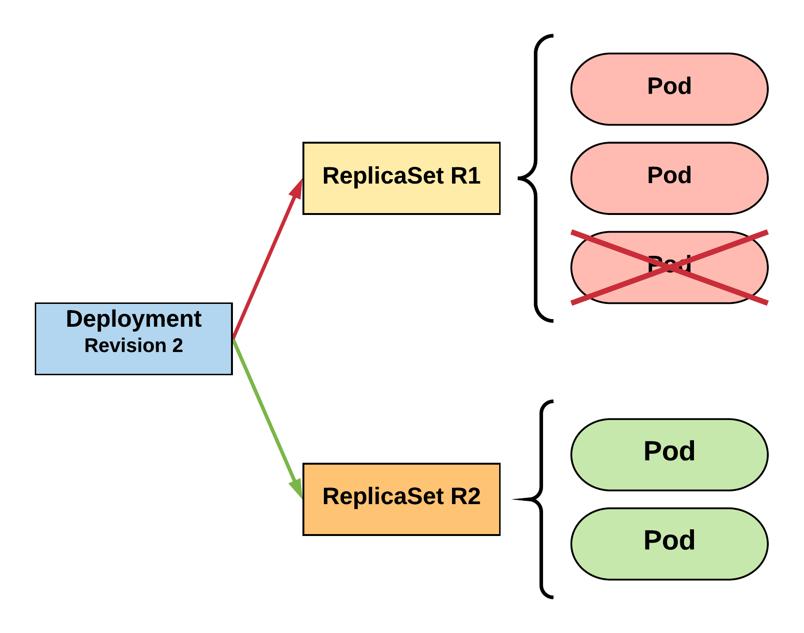
RollingUpdate Deployment
Phase out of old Pods managed by maxSurge and maxUnavailable.
R1 pod-template-hash: 676677fff
R2 pod-template-hash: 54f7ff7d6d
$ kubectl get replicaset
NAME DESIRED CURRENT READY AGE mydep-54f7ff7d6d 2 2 2 8s
mydep-6766777fff 2 2 2 5h
$ kubectl get pods
NAME READY STATUS RESTARTS AGE
mydep-54f7ff7d6d-9gvll 1/1 Running 0 5s
mydep-54f7ff7d6d-cqvlq 1/1 Running 0 2s
mydep-6766777fff-9r2zn 1/1 Running 0 5h
mydep-6766777fff-hsfz9 1/1 Running 0 5h
Notes:
It will then begin to kill off the prevision revision by scaling down the old replicaset and scaling up the new one

Slide 34
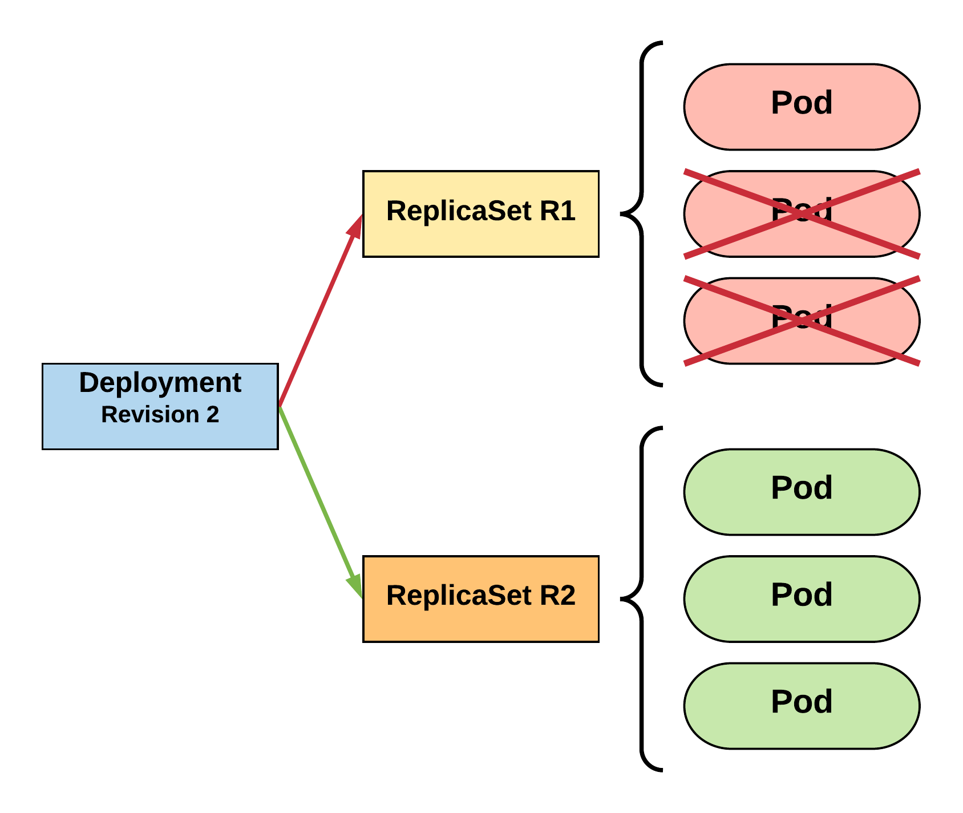
RollingUpdate Deployment
Phase out of old Pods managed by maxSurge and maxUnavailable.
R1 pod-template-hash: 676677fff
R2 pod-template-hash: 54f7ff7d6d
$ kubectl get replicaset
NAME DESIRED CURRENT READY AGE mydep-54f7ff7d6d 3 3 3 10s
mydep-6766777fff 0 1 1 5h
$ kubectl get pods
NAME READY STATUS RESTARTS AGE
mydep-54f7ff7d6d-9gvll 1/1 Running 0 7s
mydep-54f7ff7d6d-cqvlq 1/1 Running 0 5s
mydep-54f7ff7d6d-gccr6 1/1 Running 0 2s
mydep-6766777fff-9r2zn 1/1 Running 0 5h
Notes:
Continues this pattern based on maxSurge and maxUnavailable

Slide 35
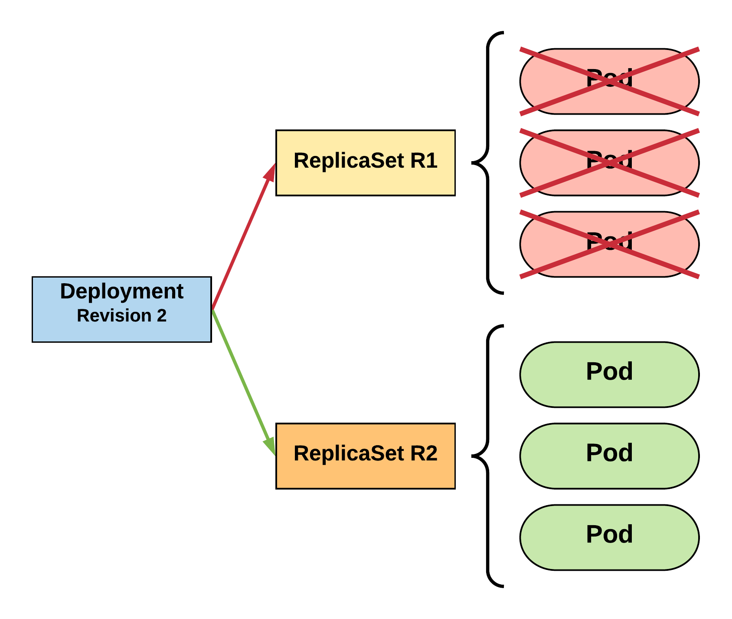
RollingUpdate Deployment
Phase out of old Pods managed by maxSurge and maxUnavailable.
R1 pod-template-hash: 676677fff
R2 pod-template-hash: 54f7ff7d6d
$ kubectl get replicaset
NAME DESIRED CURRENT READY AGE
mydep-54f7ff7d6d 3 3 3 13s mydep-6766777fff 0 0 0 5h
$ kubectl get pods
NAME READY STATUS RESTARTS AGE
mydep-54f7ff7d6d-9gvll 1/1 Running 0 10s
mydep-54f7ff7d6d-cqvlq 1/1 Running 0 8s
mydep-54f7ff7d6d-gccr6 1/1 Running 0 5s
Notes:
Update is complete

Slide 36
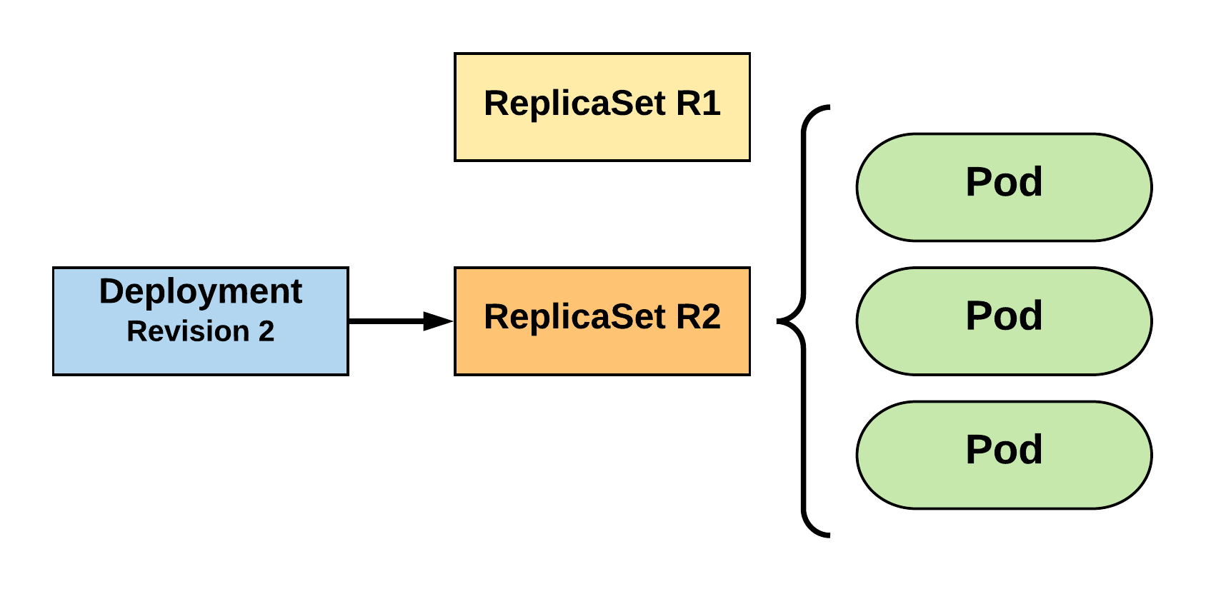
RollingUpdate Deployment
Updated to new deployment revision completed.
R1 pod-template-hash: 676677fff
R2 pod-template-hash: 54f7ff7d6d
$ kubectl get replicaset
NAME DESIRED CURRENT READY AGE mydep-54f7ff7d6d 3 3 3 15s
mydep-6766777fff 0 0 0 5h
$ kubectl get pods
NAME READY STATUS RESTARTS AGE
mydep-54f7ff7d6d-9gvll 1/1 Running 0 12s
mydep-54f7ff7d6d-cqvlq 1/1 Running 0 10s
mydep-54f7ff7d6d-gccr6 1/1 Running 0 7s
Notes:
Until the previous revision is at 0
ReplicaSet will remain around, but it will have 0 replicas. How many stay around are based off our revision history limit

Slide 37
Lab 6 – Rolling Updates
Deployment Stays Same
YAML Changes
Replace One Pod At a Time
Update Image

Slide 38
Lab 7 – Rollback Update

Slide 39
Storage
Many workloads require exchanging data between containers, or persisting some form of data
4 types of storage
Volumes
Persistent Volumes
Persistent Volume Claims
Storage Classes

Slide 40
Persistent Volume
A PersistentVolume (PV) represents a storage resource
PVs are a cluster wide resource linked to a backing storage provider: NFS, GCEPersistentDisk, RBD etc.
Generally provisioned by an administrator
Their lifecycle is handled independently from a pod
CANNOT be attached to a Pod directly. Relies on a PersistentVolumeClaim

Slide 41
Persistent Volume Cont.
You define the capacity, whether you want a filesystem or a block device, and the access mode
RWO - only a single pod will be able to (through a PVC) mount this.
ROM - many pods can mount this, but none can write.
RWM - many pods can mount and write.
apiVersion: v1
kind: PersistentVolume
metadata:
name: nfsserver
spec:
capacity:
storage: 50Gi
volumeMode: Filesystem
accessModes:
- ReadWriteOnce
- ReadWriteMany
persistentVolumeReclaimPolicy: Delete
storageClassName: slow mountOptions:
- hard
- nfsvers=4.1
nfs:
path: /exports
server: 172.22.0.42

Slide 42
Persistent Volume Claims
A PersistentVolumeClaim (PVC) is a namespaced request for storage.
Satisfies a set of requirements instead of mapping to a storage resource directly.
Ensures that an application’s ‘claim’ for storage is portable across numerous backends or providers.
PVCs can be named the same to make things consistent but point to different storage classes

Slide 43
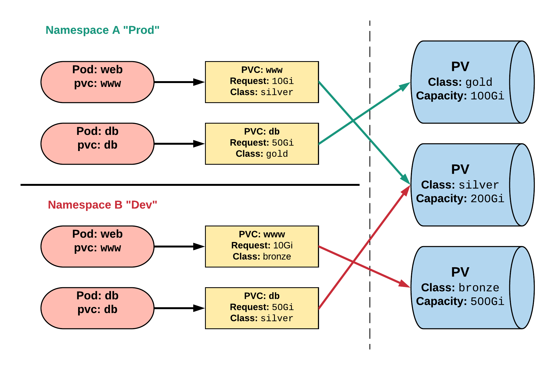
Persistent Volume & Claims
Cluster Users
Cluster Admins

Slide 44
Persistent Volume Phases
Available
PV is ready and available to be consumed.
Bound
The PV has been bound to a claim.
Released
The binding PVC has been deleted, and the PV is pending reclamation.
Failed
An error has been encountered attempting to reclaim the PV.

Slide 45
Lab 8 – Persistent Volumes

Slide 46
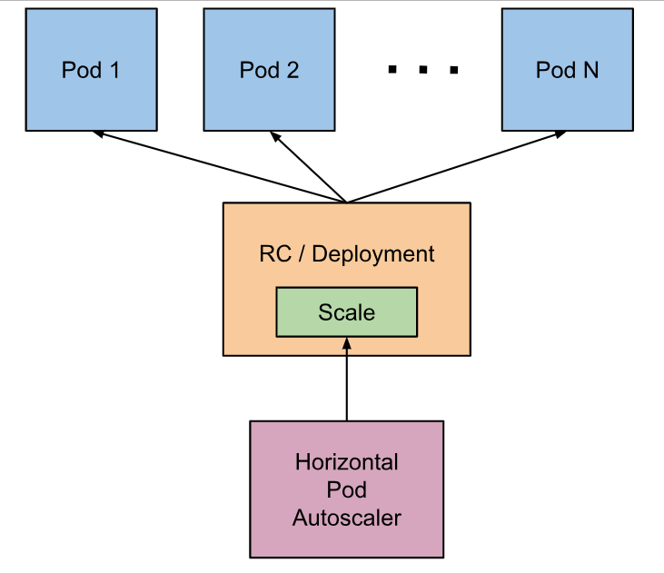
Horizontal Pod Autoscaling (HPA)
The Horizontal Pod Autoscaler automatically scales the number of pods in a replication controller, deployment or replica set based on observed CPU utilization or other metrics
The Horizontal Pod Autoscaler is implemented as a Kubernetes API resource and a controller
https://kubernetes.io/docs/tasks/run-application/horizontal-pod-autoscale/

Slide 47
Lab 9 – Auto Scale Pods
Deploy your app
Add load on your app
Number of Pods will go up, automatically, based on load
Reduce load on your app
Number of Pods will go down, automatically, based on load

Slide 48
Key Takeaways
Deploy Compose App in K8
API & Objects
Networking
Services
Replica Sets
Deployments
Storage
Auto Scaling for Apps

Slide 49
This concludes Chapter 4 Container Orchestration with Kubernetes

